Slide 1
Sorting & Searching

Slide 2
Searching
Goal: find the index of an element in an array
E.g. [1, 2, 5, 4, 3] find(5) → 2

Slide 3
Naïve Solution: Sequential Search
Iterate through the array
Return the index if the element is found
public static int index(int[] arr, int element) {
for (int i = 0; i < arr.length; i++) {
if (arr[i] == element) {
return i;
}
}
return -1;
}

Slide 4
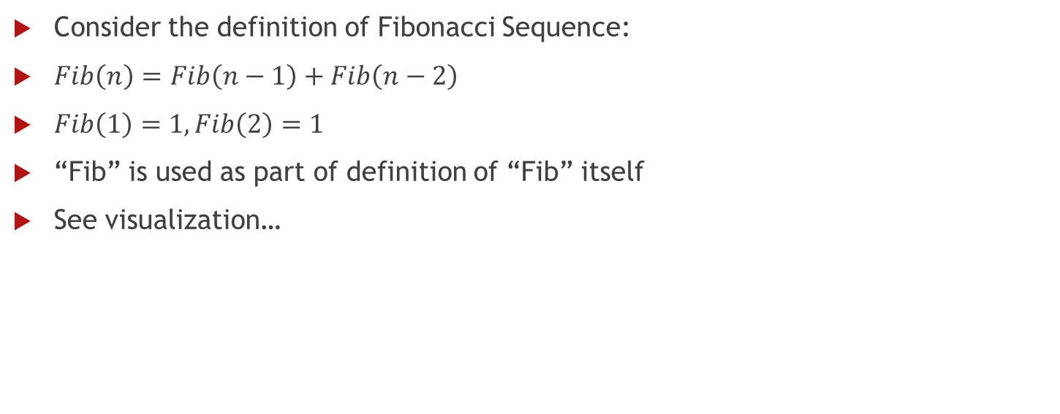
Recursion
Consider the definition of Fibonacci Sequence:
$Fib\left(n\right)=Fib\left(n−1\right)+Fib\left(n−2\right)$
$Fib\left(1\right)=1, Fib\left(2\right)=1$
“Fib” is used as part of definition of “Fib” itself
See visualization…

Slide 5
Recursion – Fibonacci Sequence
public static int fib(int n) {
if (n == 1) return 1;
if (n == 2) return 1;
return fib(n - 1) + fib(n - 2);
}
Try it out

Slide 6

Recursion - Selection
Select k elements from n elements
$C\left(n,k\right)=C\left(n−1,k\right)+C(n−1,k−1)$
$C\left(n, 0\right)=1,C\left(n,n\right)=1$
public static int select(int n, int k) {
…
}

Slide 7
Recursion - Selection
public static int select(int n, int k) {
if (k == 0 || k == n) return 1;
else {
return select(n - 1, k)
+ select(n - 1, k - 1)
}
}

Slide 8
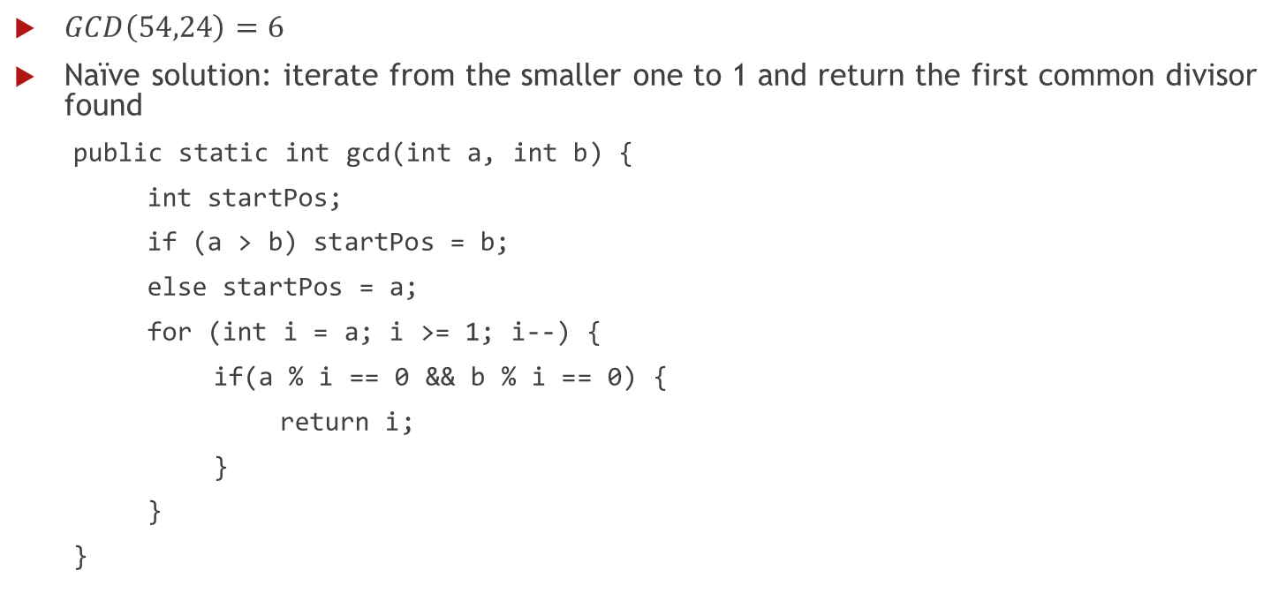
Greatest Common Divisor
$GCD\left(54,24\right)=6$
Naïve solution: iterate from the smaller one to 1 and return the first common divisor found
public static int gcd(int a, int b) {
int startPos;
if (a > b) startPos = b;
else startPos = a;
for (int i = a; i >= 1; i--) {
if(a % i == 0 && b % i == 0) {
return i;
}
}
}

Slide 9
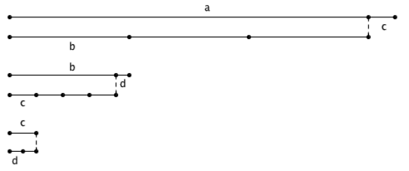
GCD – Euclid’s Algorithm

Slide 10

Euclid’s Algorithm
$GCD\left(a, 0\right)=a$
$GCD\left(a, b\right)=GCD(b, a mod b)$
Try it out!

Slide 11
Binary Search
Number guessing game
I’m thinking of a number between 0 and 100
I’ll respond to your guesses with “higher”, “lower” and “Yes!”
Strategy: …
L = 1 3 4 6 8 9 11; X = 4
Compare X to 6. X is smaller. Repeat with L = 1 3 4.
Compare X to 3. X is bigger. Repeat with L = 4.
Compare X to 4. They are equal. We're done, we found X.

Slide 12
Binary Search – Source Code
public static int bSearch(int arr[], int key, int l, int r) {
if (l < r) {
return -1;
}
else {
int m = (l + r) / 2;
if (arr[m] > key) {
return bSearch(arr, key, l, m - 1);
}
else if (arr[m] < key) {
return bSearch(arr, key, m + 1, r);
}
else {
return m;
}
}
}

